Slide 1


Team 36: Voice-Controlled Wheelchair
Bi-Weekly Update 4 Nathan Philipello, Juan Alcala, Saleem Joubran, Nishant Murali TA: Hadiur Khan
Notes:
Take your time

Slide 2
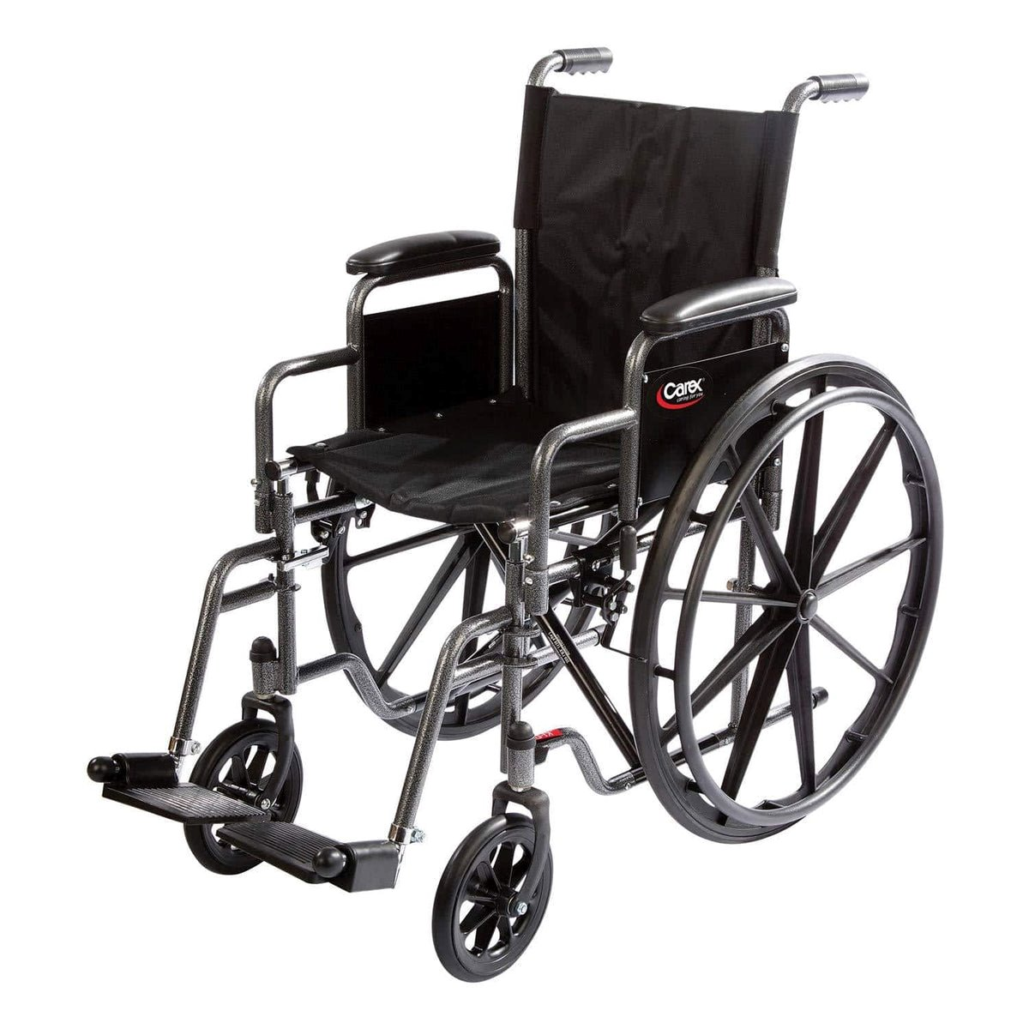
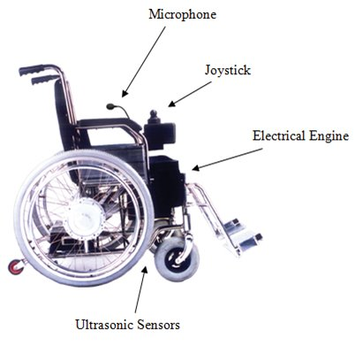
Project Summary
Problem:
Many wheelchair users face challenges operating manual controls, which can require caregiver assistance and limit independence.
Proposed Solution:
A voice-controlled navigation system enables hands-free operation of the wheelchair, increasing independence, safety, and convenience for all users.
Notes:
30 seconds Saleem

Slide 3
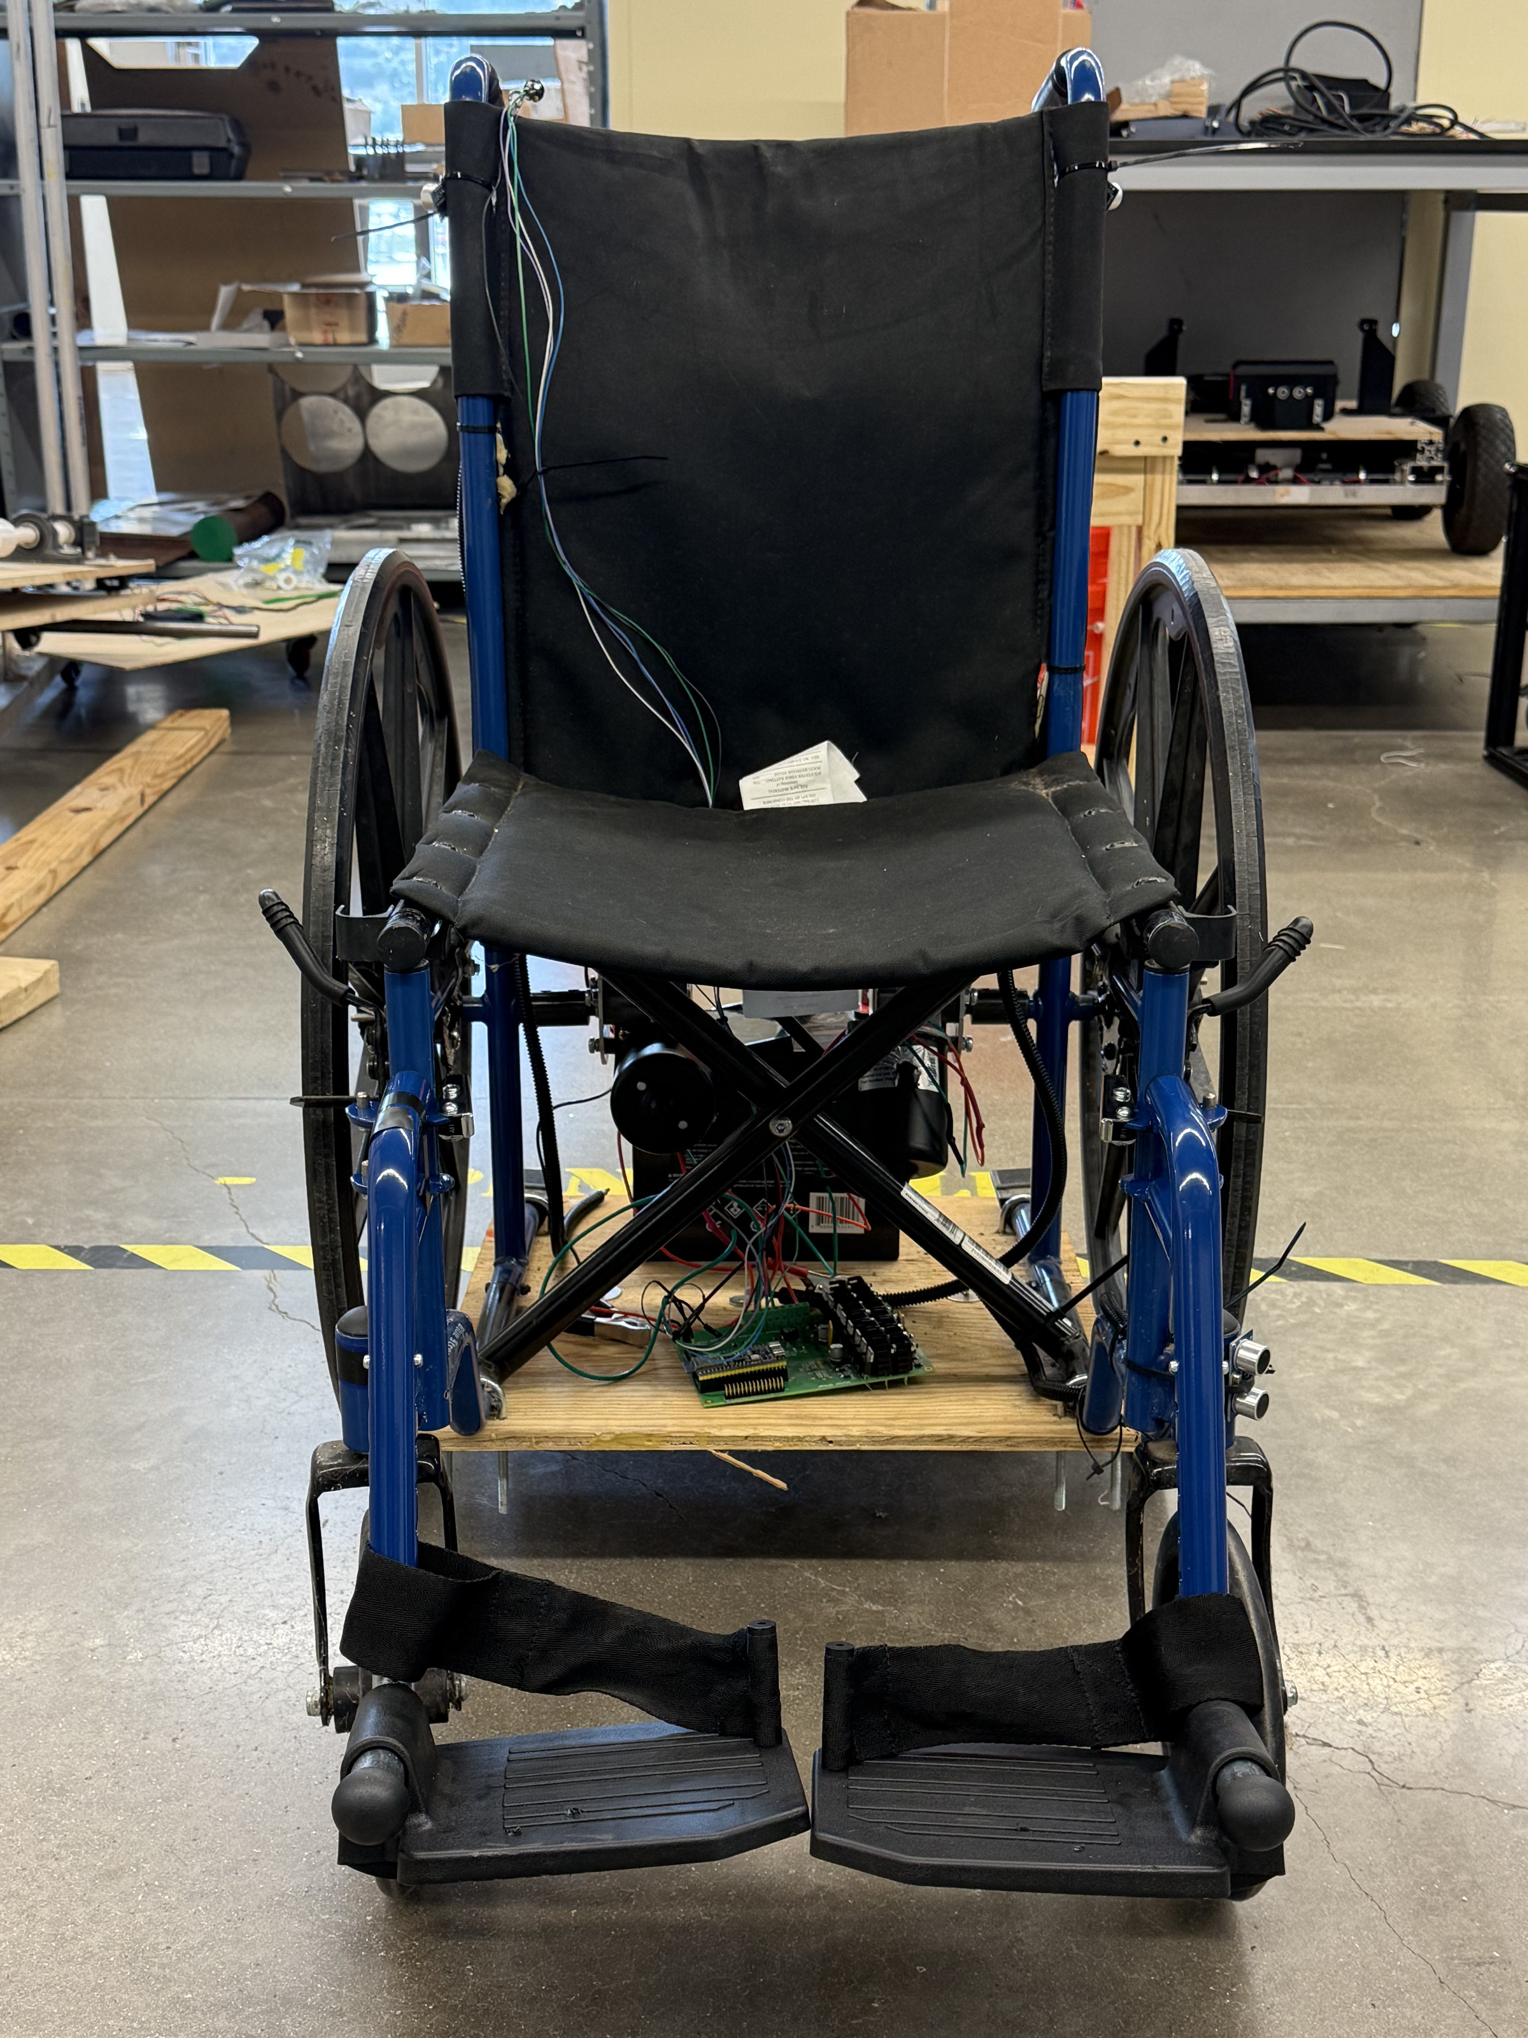
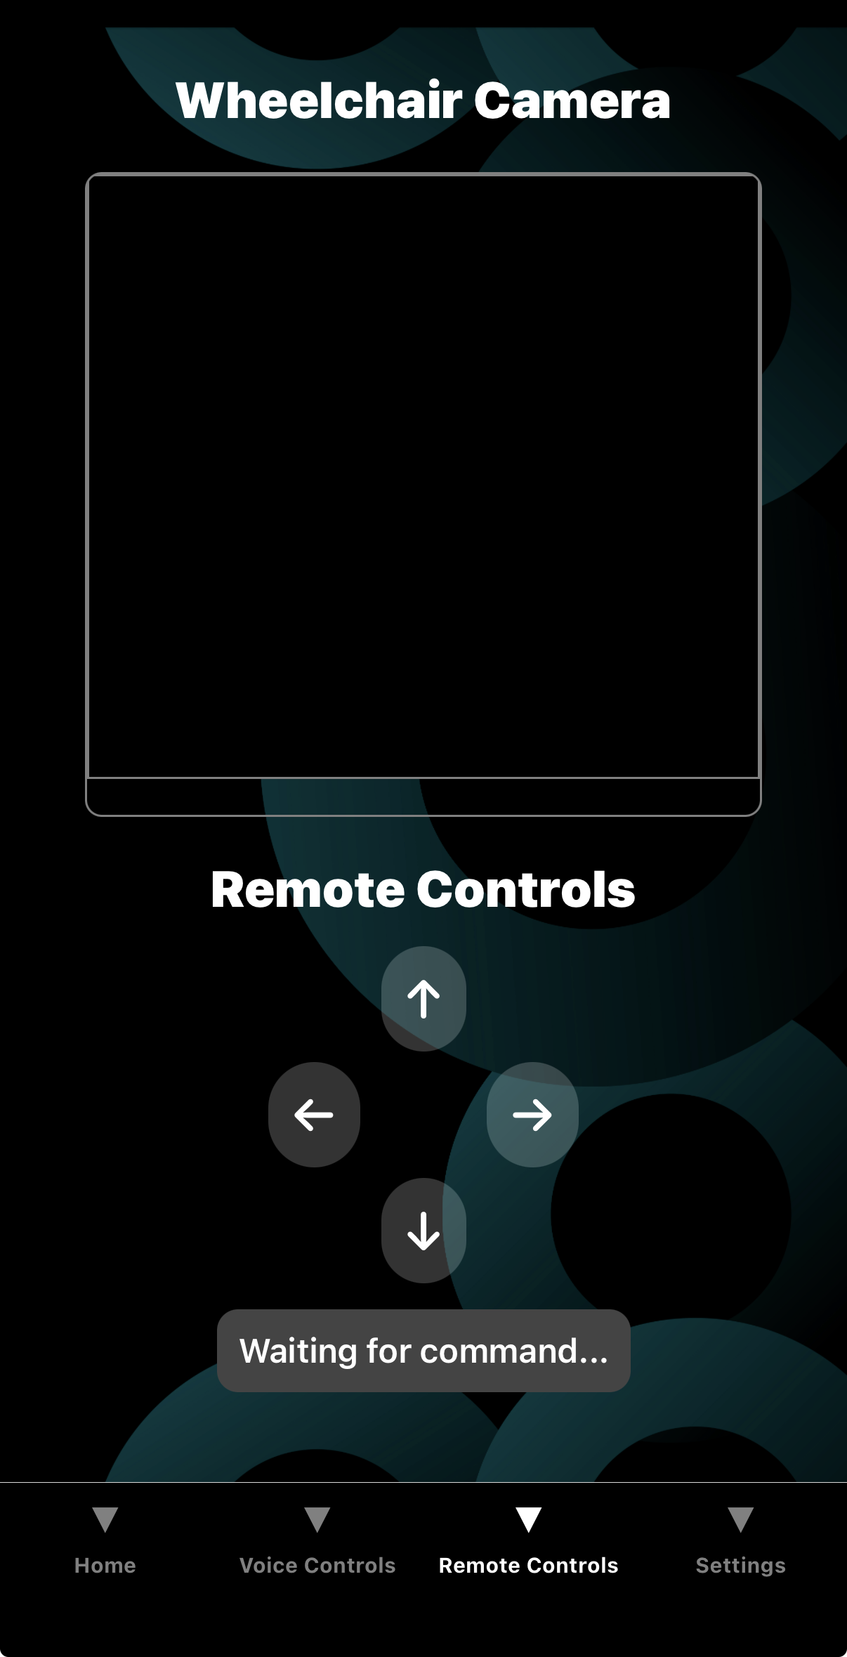
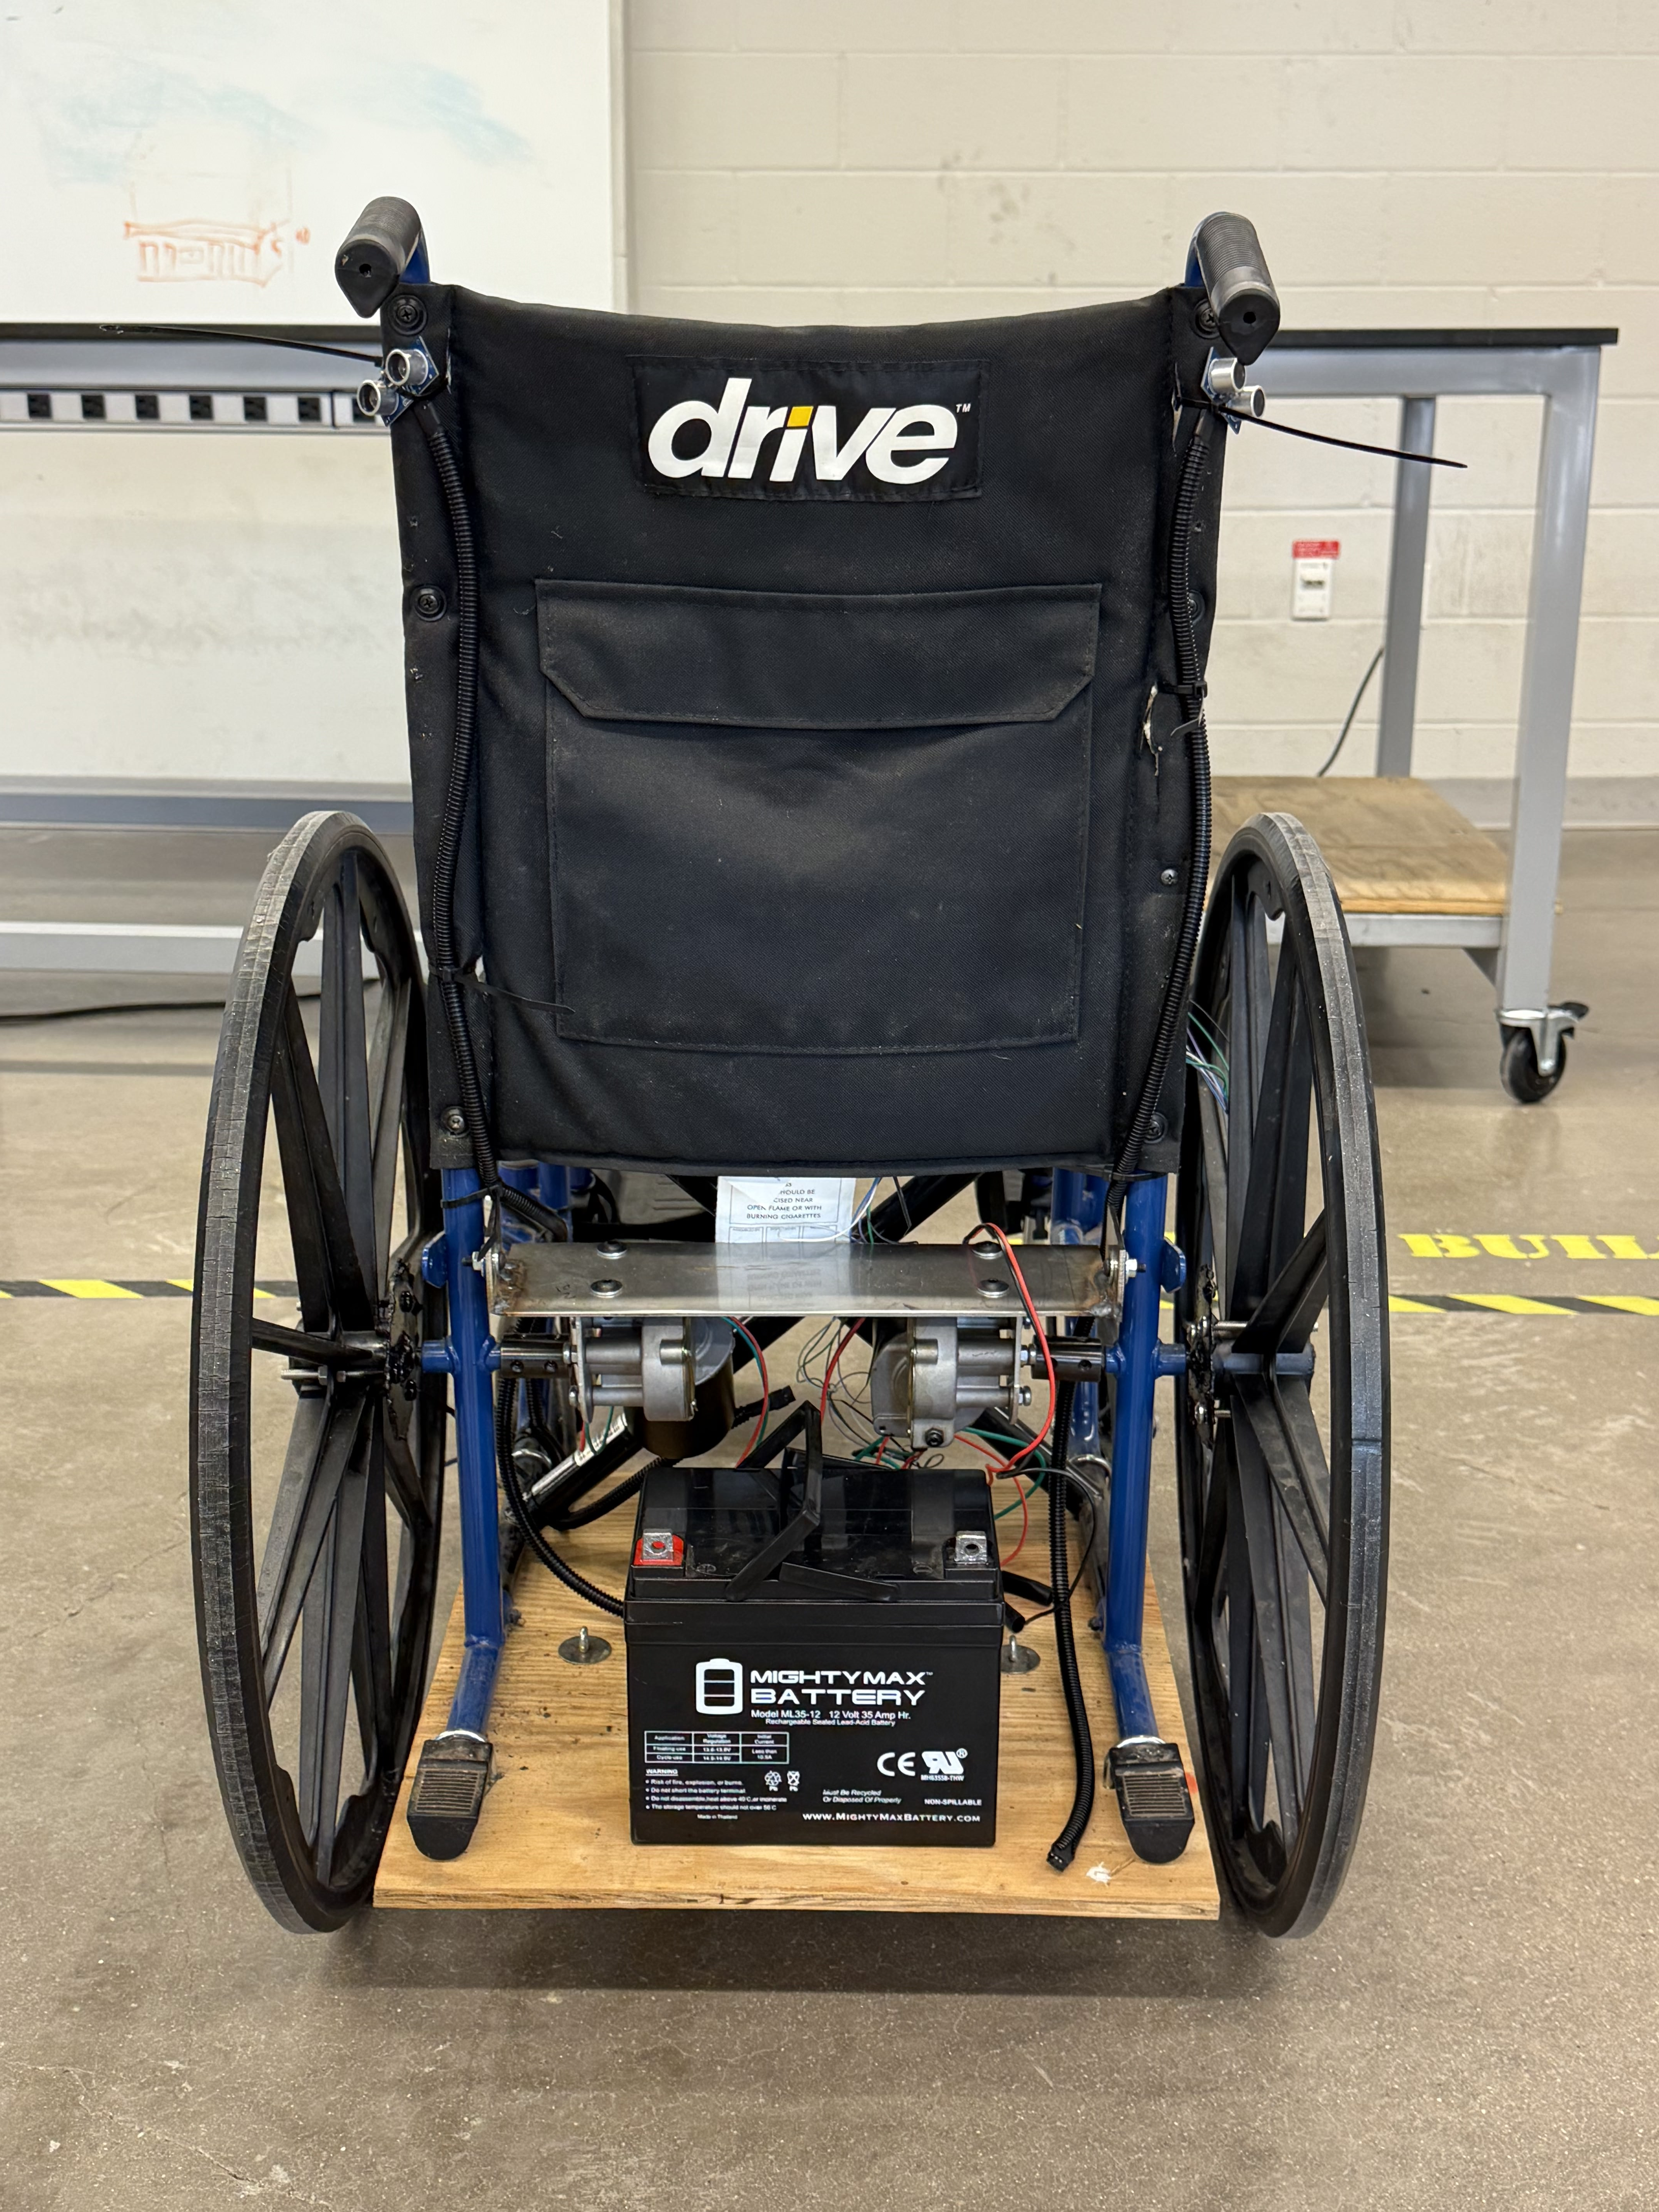
Project/Subsystem Overview
Microphone
Mobile App
Rear Facing Sensors
Camera Stream
Integrated PCB
Direct Drive DC Brushed Motors
Battery
Camera
Frontward Facing Sensors
Downward Facing Sensors
Notes:
NOT A BLOCK DIAGRAM. A PICTURE OF WHEELCHAIR WITH LABELD PARTS Nathan Integrated System Diagram (90 seconds) This should show the complete system – with picture of packaged solution or conceptual diagram of packaged solution. Use this to describe how user interacts with system and how system interacts with external environment. Show how it connects to the outside world (communication, interfaces). If appropriate show internal breakdown and interfaces. SW projects should show data repository/db; mobile/web app connectivity; front end vs backend; and give representative screens users will see – real look-and- feel NOTE this is not your usual system block diagram

Slide 4
Project Timeline
Order designed PCB (Completed 9/18) | Integrate voice command on the motors (Completed 9/18) | Integrate voice command to the app (Complete by 9/26) | Integrate mobile app to motor control (Complete by 10/1) | Validate mobile app controls with motor driver (Completed by 10/8) | Validate wheelchair can handle weight limit (Complete by 11/7) | Validate control and response time (Complete by 11/7)
Notes:
30 sec High level figure showing where you are at in the project, what’s completed, what’s underway – it should take about 30 seconds to summarize where you are in the timeline
-- Save discussion for subsystem update
-- Save detail for execution plan & validation plan status
Nishant

Slide 5
Voice Command Recognition
Saleem Joubran
Accomplishments since last update 28 hours of effort | Ongoing progress/problems and plans until the next presentation
Implemented and tested PWM speed control from voice commands on the wheelchair Added a push button near the microphone as an “E-stop” | Validate motor response time Integrate sensor logic with main code
Notes:
For 4th review Accomplishments should include what integration and functional/range/error system testing completed and planned for next 2 weeks” “Completed integration of all subsystems” “Verified sensor data capture and communication through Bluetooth to App” “Integrated image detection model on Pi-4 on drone, tested detection accuracy” “Tested app error handling for stuck valve & thermal range exceeded cases” “ON-GOING automated software testing” “Range testing of LoRa network from 10m to 5km with 35 points in BCS” “Rover motor stall test with 2x max payload and 40o elevation by next review”

Slide 6
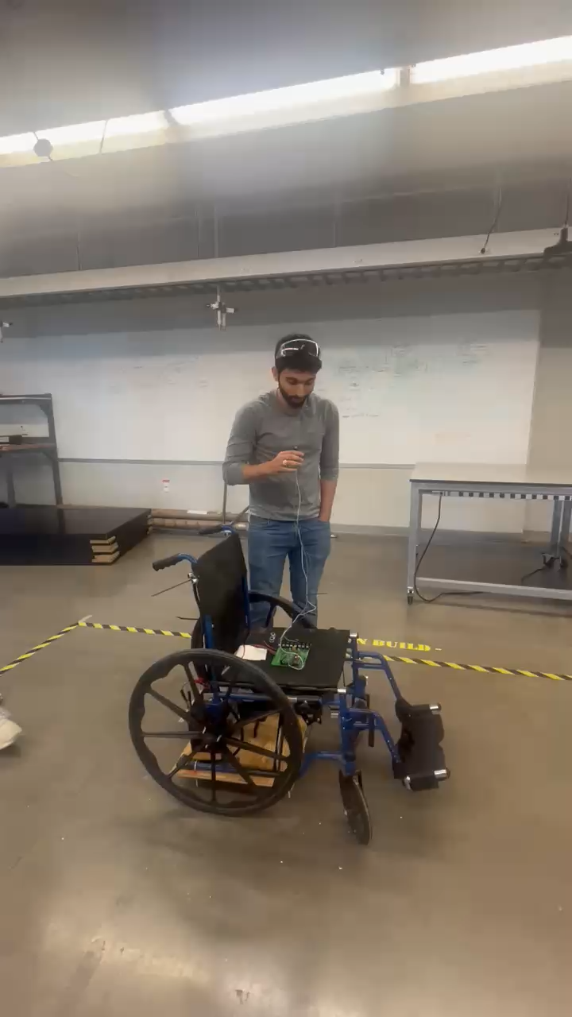
Voice Command Recognition
There is an initial delay to get the motors to start up
There is a small delay between consecutive commands to prevent damage to the motors
Microphone will be attached to a headset to place on the user
Notes:
This should all be test results! – show things working, functional test results, error checking, etc Show test results for integrated systems Park Mode? (Stationary for a while)

Slide 7
Mobile Control and Monitoring
Nishant Murali
Accomplishments since last update 24 hrs of effort | Ongoing progress/problems and plans until the next presentation
Implemented and tested PWM speed control from app commands on the wheelchair | Validate motor response time Ongoing range testing of ESP32-S3 and Mobile app connection
Notes:
45 sec

Slide 8
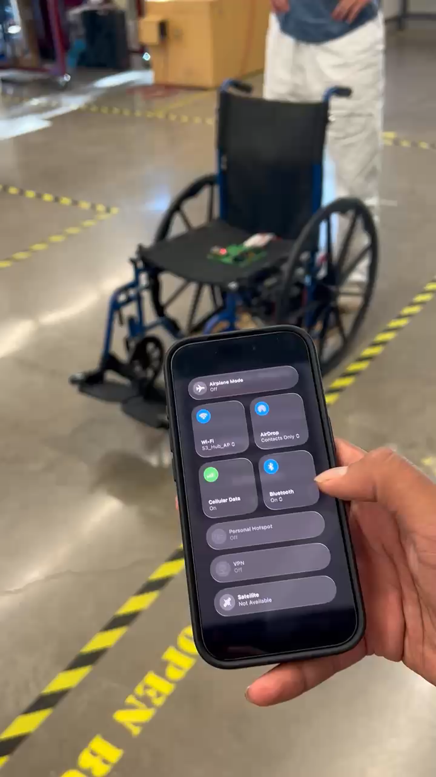
Mobile Control and Monitoring
Nishant Murali
Loose shaft coupler caused unintended turning during forward/backward motion
Front caster wheels are free-rotating, so initial misalignment can cause slight instability until they self-align
Initial range testing for the ESP32-S3 access point is ~18 meters
Notes:
45 sec

Slide 9
Motor Driver & Sensors
Nathan Philipello
Accomplishments since last update 28 hrs of effort | Ongoing progress/problems and plans until the next presentation
Created Wiring harnesses for sensors as well as mounted them all in place | Test sensors and reimplement them into the integrated code Testing of validation plan subsystems
Notes:
For 4th review Accomplishments should include what integration and functional/range/error system testing completed and planned for next 2 weeks” “Completed integration of all subsystems” “Verified sensor data capture and communication through Bluetooth to App” “Integrated image detection model on Pi-4 on drone, tested detection accuracy” “Tested app error handling for stuck valve & thermal range exceeded cases” “ON-GOING automated software testing” “Range testing of LoRa network from 10m to 5km with 35 points in BCS” “Rover motor stall test with 2x max payload and 40o elevation by next review”

Slide 10
Motor Driver & Sensors Nathan Philipello
Created Wiring Harnesses for Sensors for seamless integration
Helped with integration of Voice Control and App

Slide 11
Power
Juan Alcala
Accomplishments since last update 26 hrs of effort | Ongoing progress/problems and plans until the next presentation
Integrated board successfully delivered power to the system Enclosure finished and sent to prototyping center | Run an outdoor field test to make sure the wheelchair is operable under typical outdoor conditions
Notes:
45 sec

Slide 12
Power
Juan Alcala
Integration Updates
3.3V converter not functional
After discussing with Dr. Lusher, 3.3V will be supplied via the 3.3V pin on the ESP32
Updated total consumption for 3.3V loads: Microphone - 10mA
5V converter functional under new consumption – 870mA
Board can handle the high current (11A peak) from the motor drivers during integration testing
Enclosure for PCB finished
Clear airflow path with cut outs for intake and exhaust fans
Enclosure measurements: 230x160x90mm
In queue to print at the prototyping center
Notes:
45 sec

Slide 13
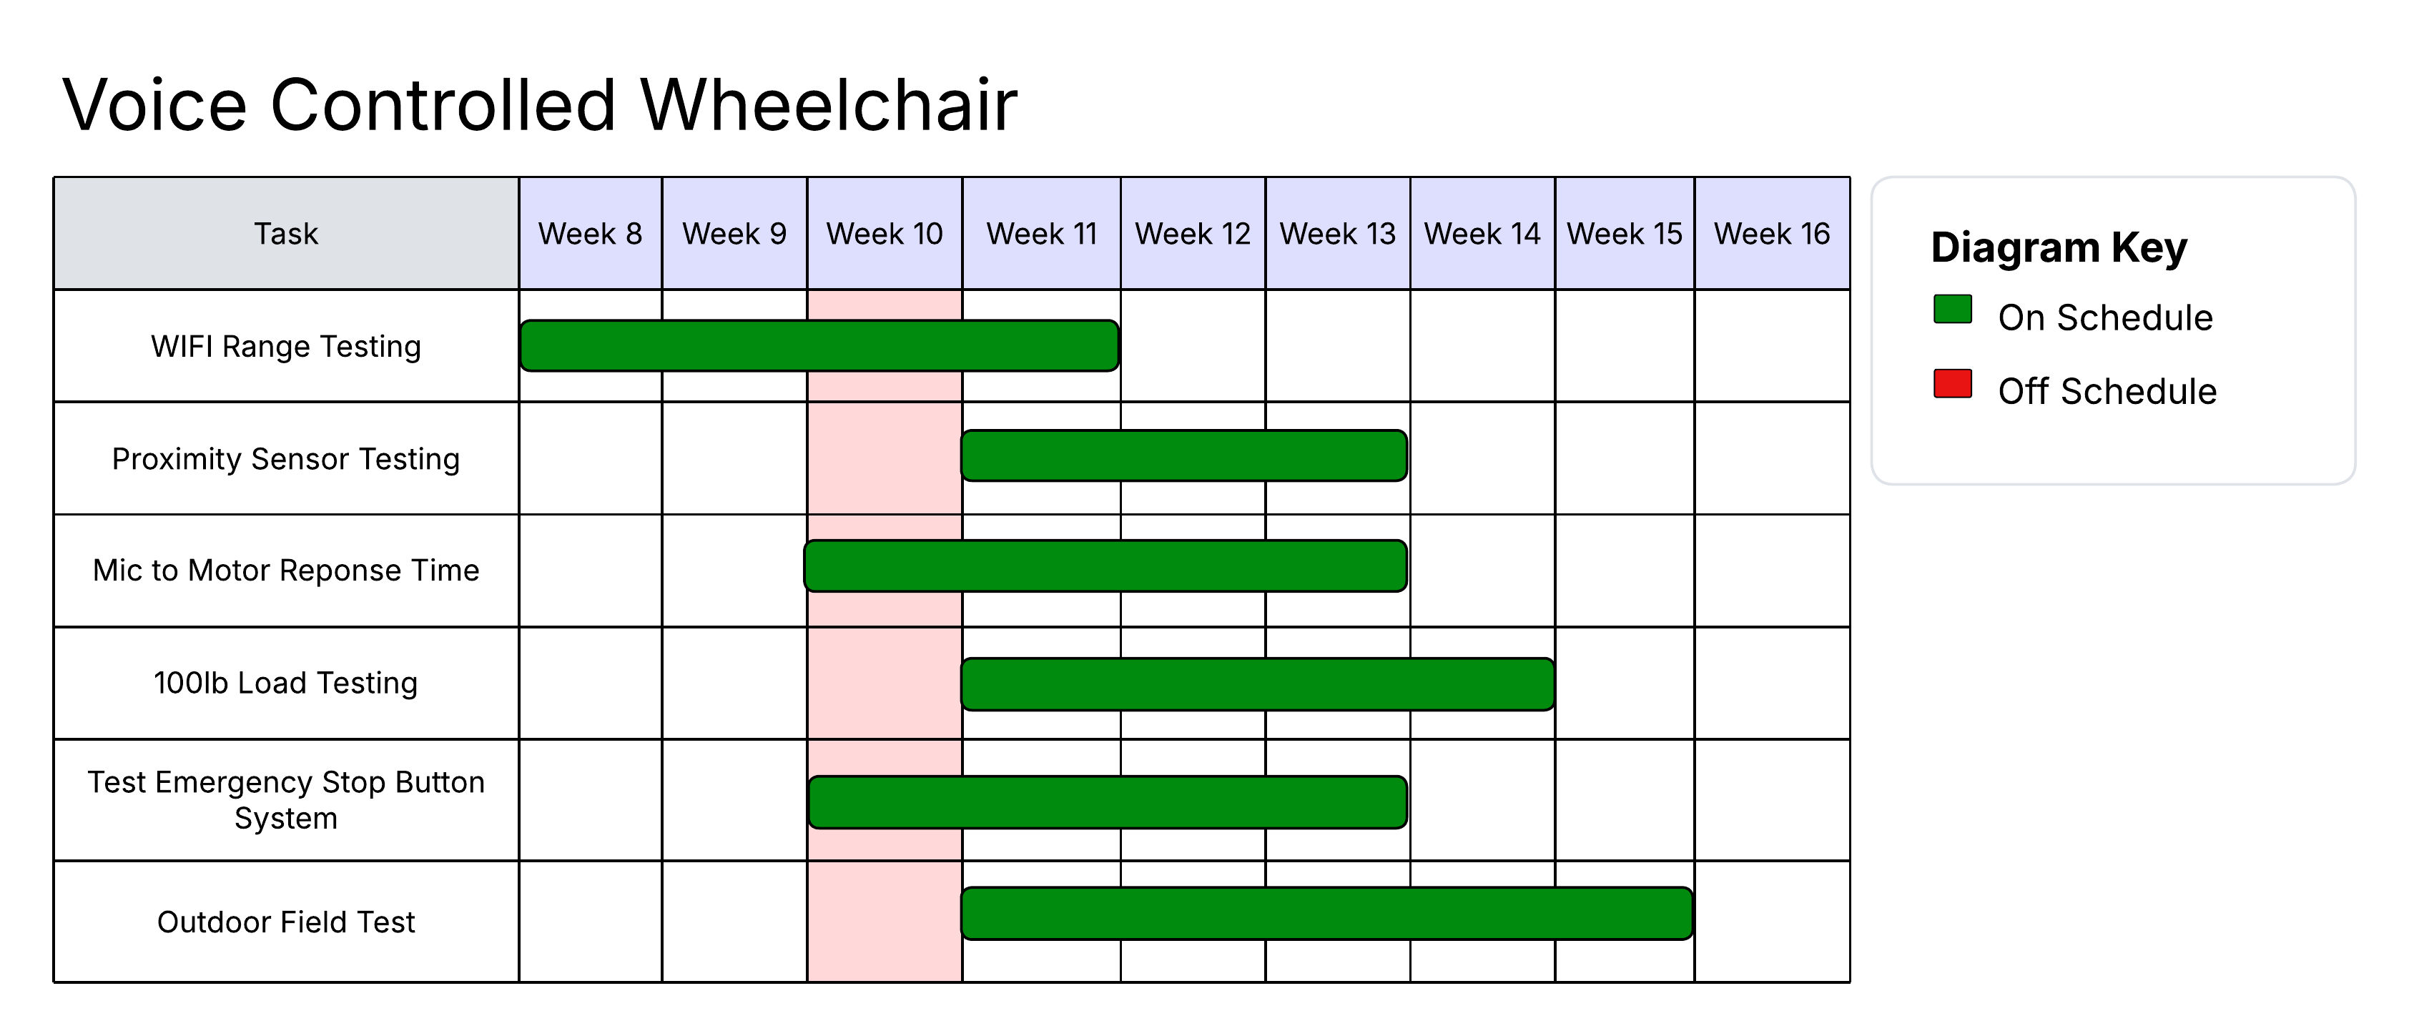
Execution Plan
Notes:
Execution plan • Your team planned milestones for completion of any remaining integration, functional, range, and error test, and validation plans should be presented. • Milestones should have owners ... system tests, and full system integration can be group owned • Engineering milestones only [presentation, demo, document due dates are project milestone that do not belong on this chart] • Gantt chart. • DO NOT try to discuss all milestones in the plan – just high priority present and next engineering milestones

Slide 14
System Validation Plan
Name | Requirement | Success Criteria | Methodology | Responsible party | Status
Emergency Stop Test | Pressing the E-Stop immediately shuts off all motor outputs | Motors stop within about 500 ms of button pressed | Press E-stop on various commands and record the time it takes for motors to fully stop | Saleem | In progress
Proximity Sensor Shutdown | The wheelchair must automatically stop its movement when the proximity sensors detect an obstacle within a preset safe distance of 25 cm | The wheelchair halts all movement within 1 second when an obstacle comes within the defined safety zone. | Perform tests by placing obstacles of various sizes and materials at different distances from the wheelchair while it is in motion. Measure the sensor’s accuracy and the time taken for the wheelchair to stop upon detecting an obstacle. | Nathan | In progress
Response Time | Voice command to motor actuation latency must be bounded under load | Measure motor response is under 1000ms from Mic | Time the response from microphone to motor movement | Saleem | In progress
100lb Load Test | The wheelchair must reliably support and operate with a maximum load of 100lb without any electrical, mechanical, or operational failures. | The wheelchair functions normally and safely when carrying a load of 100lb. There are no signs of excessive strain, deformation, or malfunction in any part of the wheelchair during and after the test. | Gradually apply weights to the wheelchair until the total load is 100lb. Operate the wheelchair under this load, including starting, stopping, turning, and all system features. | Juan | In progress
Wi-Fi Range Testing | The ESP32-S3’s Wi-Fi network must maintain a stable connection between the wheelchair and the user’s control device within a reasonable operating range. | The connection remains stable and responsive (no command delay or dropout) up to 15 meters in open space; signal strength ≥ –70 dBm; reconnection within 5 s after temporary loss. | Use a mobile device or laptop to connect to the ESP32-S3 SoftAP. Send control commands while gradually increasing the distance in 1 m increments. Record RSSI values, latency, and packet loss. Test in both indoor (obstructed) and outdoor (line-of-sight) conditions. | Nishant | In progress
Outdoor Field Test | The wheelchair must operate safely and reliably under typical outdoor conditions (uneven surfaces, sunlight, mild wind noise). | The system correctly interprets all voice commands, maintains stable motion control, and stops safely when obstacles or E-Stop are triggered. No unexpected resets, overheating, or false commands during a 30-minute continuous run | Conduct a controlled outdoor test on pavement and grass. Observe motor temperature, microphone reliability under ambient noise, Wi-Fi performance, and proximity/E-Stop functionality. Log all faults or abnormal behaviors during operation. | Nathan | In progress
Notes:
Consult wifi issue with nowka
Validation plan – any major thing missing? alidation plan • This is not a gantt chart. • Validation plan is a table showing: • Name: descriptive short description of what is being validated, • Requirement: Identifer to link to requirement # from conops/fsr/icd • Success Criteria for validation – range/lifetime/performance metric/physical limit...that must be met. • Methodology – test procedure followed/observations made/simulations completed/.. to satisfy the validation • Responsible party • Status – complete/not complete

Slide 15
Thank you!

